Slide 1
24CYS204 - ADVANCED PROGRAMMING

Slide 2
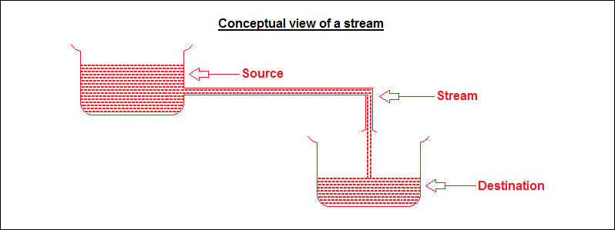
What is a Stream?
Path along which the data flows

Slide 3
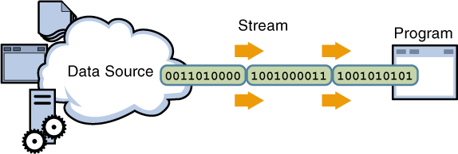
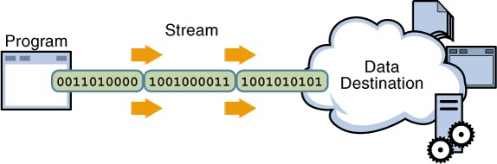
What is a Stream?
Linked to a physical layer by java I/O system to make input and output operation

Slide 4









Types of stream :
Java encapsulates Stream under java.io package
Stream
Byte Stream
Character Stream
Perform input and output of 8-bit bytes
Perform input and output for 16-bit unicode

Slide 5
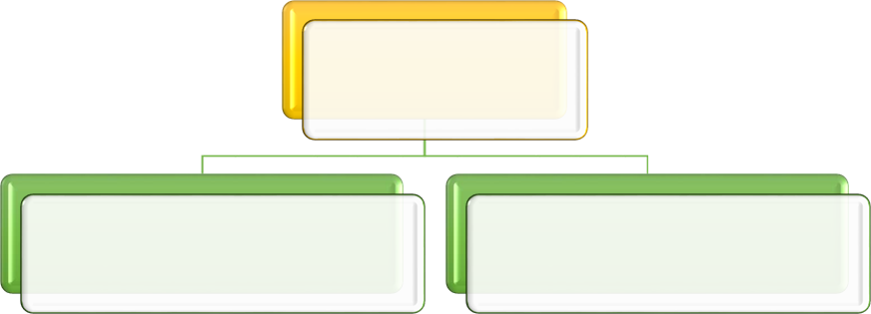
Types of stream :
Stream
Input Stream
Output Stream

Slide 6
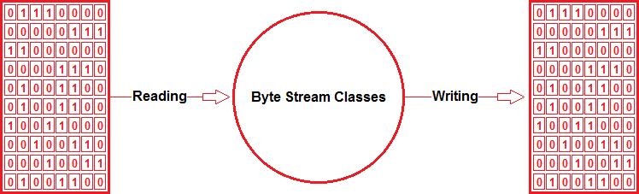

Byte stream :
Have several concrete classes that handle various devices such as disk
files, network connection etc.

Slide 7
Byte stream types :
Input Stream
Output Stream
InputStream and OutputStream are abstract class and therefore we cannot create instances

Slide 8
Byte stream subclasses :
Stream class | Description
BufferedInputStream | Used for Buffered Input Stream.
BufferedOutputStream | Used for Buffered Output Stream.
DataInputStream | Contains method for reading java standard datatype
DataOutputStream | An output stream that contain method for writing java standard data type
FileInputStream | Input stream that reads from a file
FileOutputStream | Output stream that write to a file.
InputStream | Abstract class that describe stream input.
OutputStream | Abstract class that describe stream output.
PrintStream | Output Stream that contain print() and println() method

Slide 9
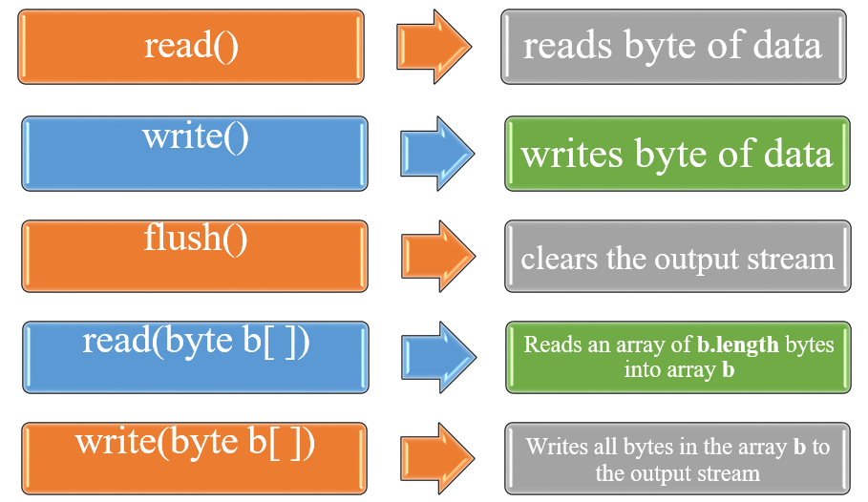
Important methods:

Slide 10
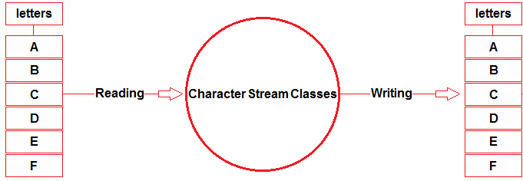
Character stream:
Have several concrete classes that handle Unicode character

Slide 11
character stream types :
Reader
Writer
Only difference is that while byte stream classes are designed to read and write bytes, the character stream classes are designed to read and write character

Slide 12
character stream classes :
Stream class | Description
BufferedReader | Handles buffered input stream.
BufferedWriter | Handles buffered output stream.
FileReader | Input stream that reads from file.
FileWriter | Output stream that writes to file.
InputStreamReader | Input stream that translate byte to character
OutputStreamReader | Output stream that translate character to byte.
PrintWriter | Output Stream that contain print() and println() method.
Reader | Abstract class that define character stream input
Writer | Abstract class that define character stream output

Slide 13
Ways to read from console :
Scanner
BufferedReader
Console

Slide 14
Using scanner :

Slide 15
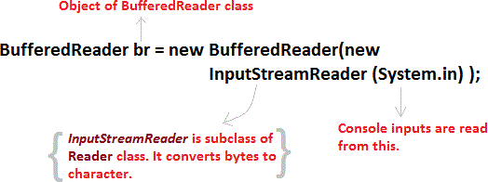
Using bufferedreader :

Slide 16
example:
Reading and Writing One Character at a time
https://onlinegdb.com/Hy2er3AIw
Reading and Writing one line at a time
https://onlinegdb.com/B1hlw308D

Slide 17
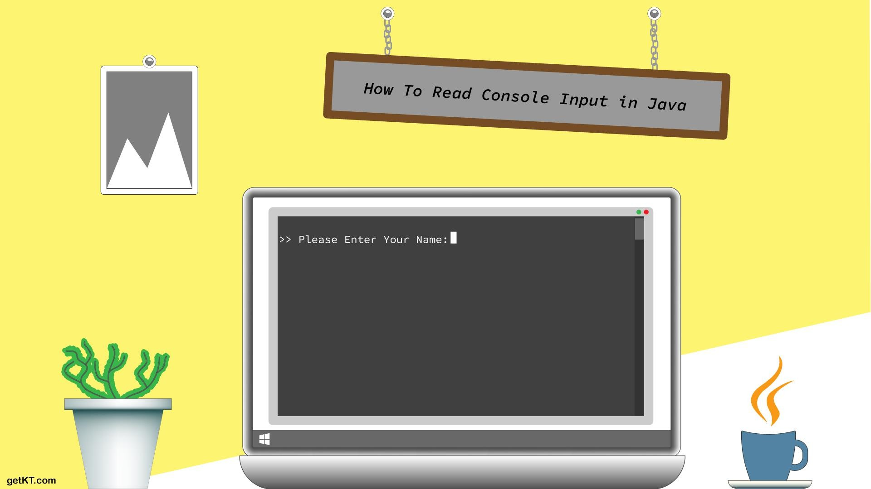
Using console:

Slide 18
console class methods:
Method | Description
Reader reader() | Gets the object of the Reader class related to the console.
String readLine() | Reads a single line of text from the console.
String readLine(String fmt, Object… args) | Provides a formatted prompt before reading the input text from the console.
char[ ] readPassword() | Reads a password that is visible on the console screen.
char[ ] readPassword(String fmt, Object… args) | Provides a formatted prompt before reading the password that is not visible on the console screen.
Console format(String fmt, Object… args) | Displays a formatted string to the console output stream.
Console printf(String format, Object… args) | Prints a string to the console output stream.
PrintWriter writer() | Get the object of the PrintWriter class.
void flush() | To flush the console.

Slide 19
examples:
Program to take input from user using the Console class:
https://onlinegdb.com/HJ56Yh6Uw
To read password from user using the Console class:
https://onlinegdb.com/BkOh3na8v

Slide 20
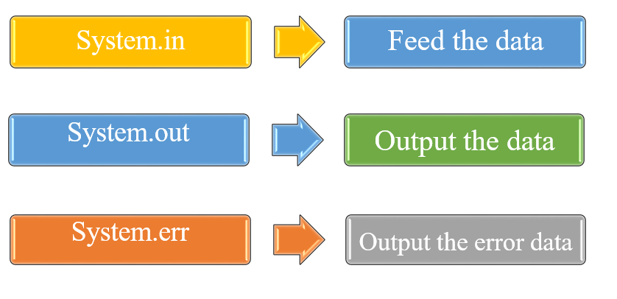
Standard streams:

Slide 21
Hands – On Practice

Slide 22
Any Queries ?
Thank You!

